Slide 1
DESIGN and ANALYSIS of ALGORITHMS HIMANSHU SRIVASTAVA CSE 2nd Year Roll no. : 181220031

Slide 2
ALL-PAIR SHORTEST-PATHS

Slide 3
ALL PAIR SHORTEST PATH
It is also known as Floyd Warshall algorithm.
It is used to find all pair shortest path problem from a given weighted graph.
i.e. shortest path from any vertex to all other vertices in the weighted graph.
As a result of this algorithm, it will generate a matrix, which will represent the minimum distance from any node to all other nodes in the graph.

Slide 4
ALL PAIR SHORTEST PATH
As a result of this algorithm, it will generate a matrix of size |V|*|V| , where v is the number of vertices in the graph.
The matrix which will represent the minimum distance from any node to all other nodes in the graph.

Slide 5
ALL PAIR SHORTEST PATH
We initialize the solution matrix same as the input graph matrix as a first step.
Then we update the solution matrix by considering all vertices as an intermediate vertex.
The idea is to one by one pick all vertices and updates all shortest paths which include the picked vertex as an intermediate vertex in the shortest path.

Slide 6
ALL PAIR SHORTEST PATH
For every pair (i, j) of the source and destination vertices respectively, there are two possible cases : -
k is not an intermediate vertex in shortest path from i to j. We keep the value of dist[i][j] as it is.
k is an intermediate vertex in shortest path from i to j. We update the value of dist[i][j] as : -
dist[i][j] = dist[i][k] + dist[k][j]
( if dist[i][j] > dist[i][k] + dist[k][j] )

Slide 7
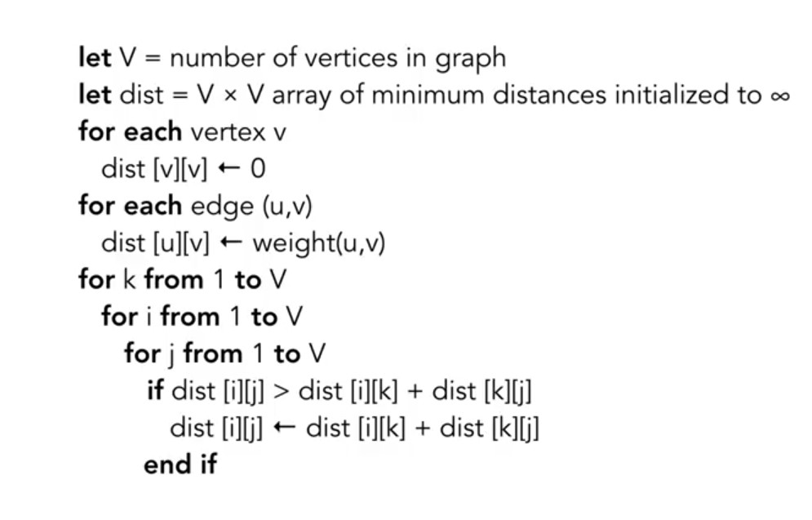
Algorithm

Slide 8
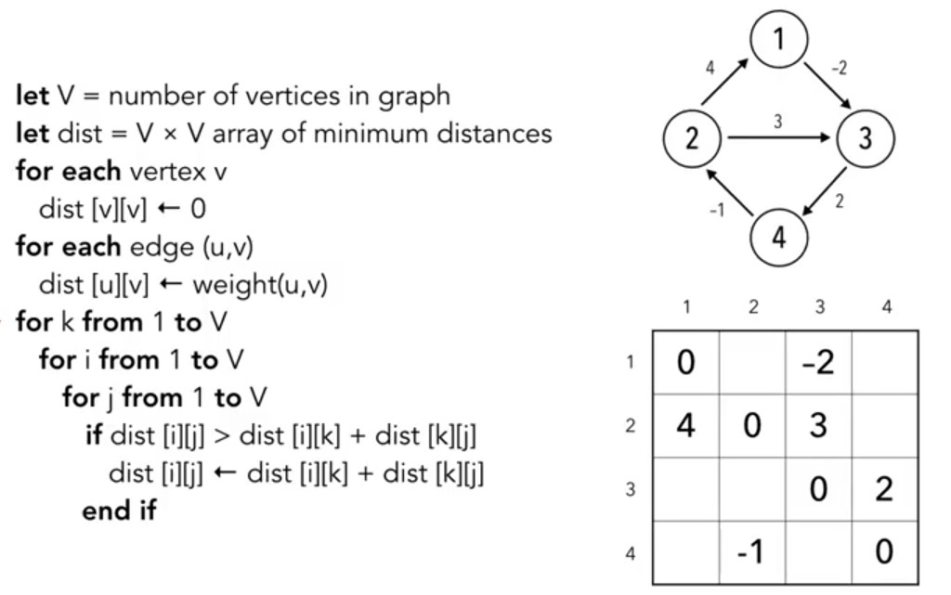
ALL PAIR SHORTEST PATH Example Problem

Slide 9
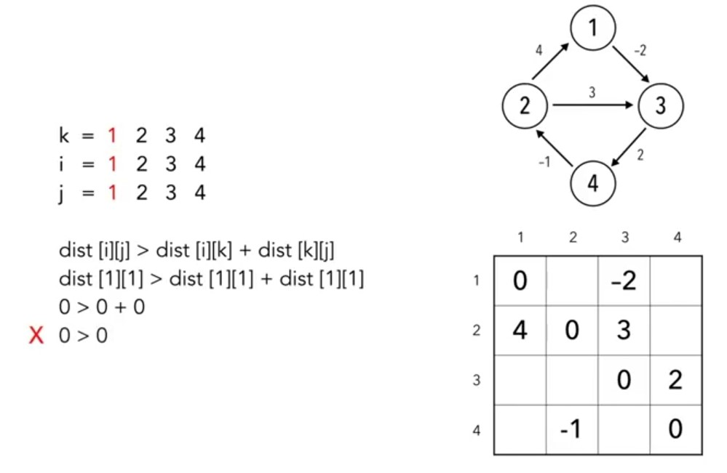
ALL PAIR SHORTEST PATH Example Problem

Slide 10
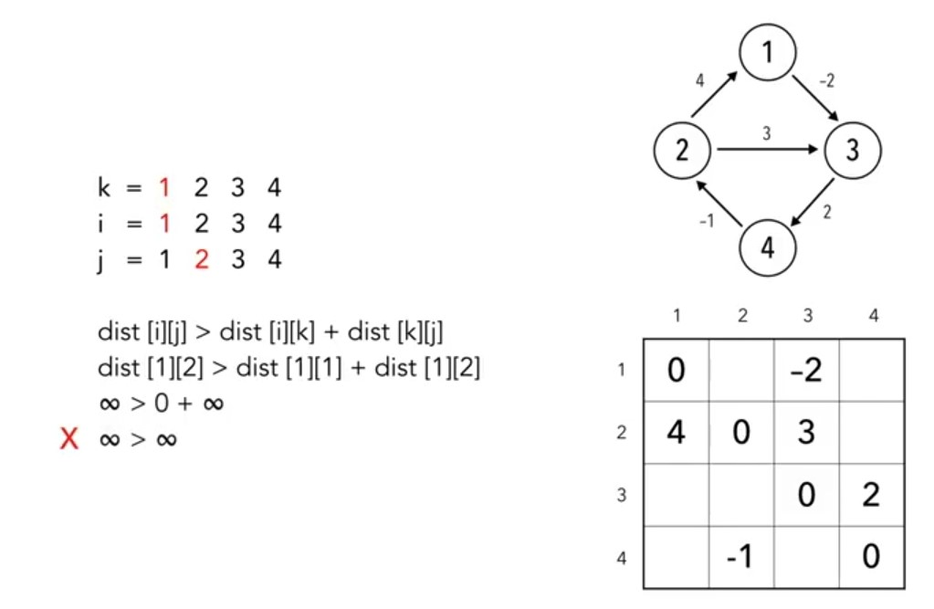
ALL PAIR SHORTEST PATH Example Problem

Slide 11
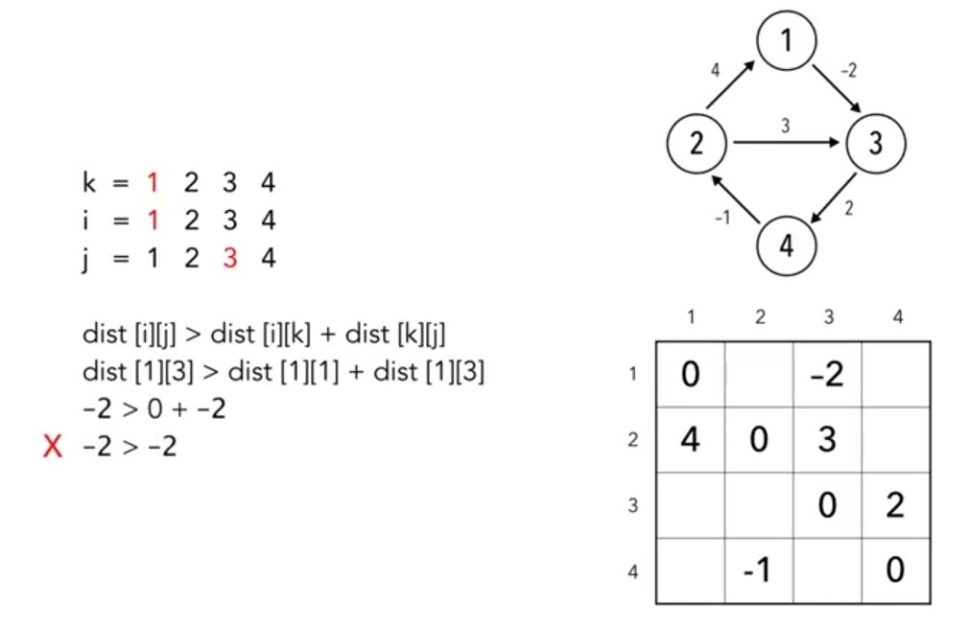
ALL PAIR SHORTEST PATH Example Problem

Slide 12
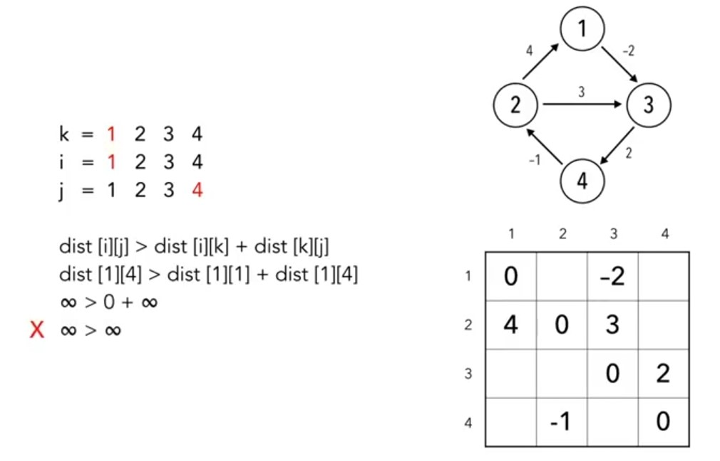
ALL PAIR SHORTEST PATH Example Problem

Slide 13
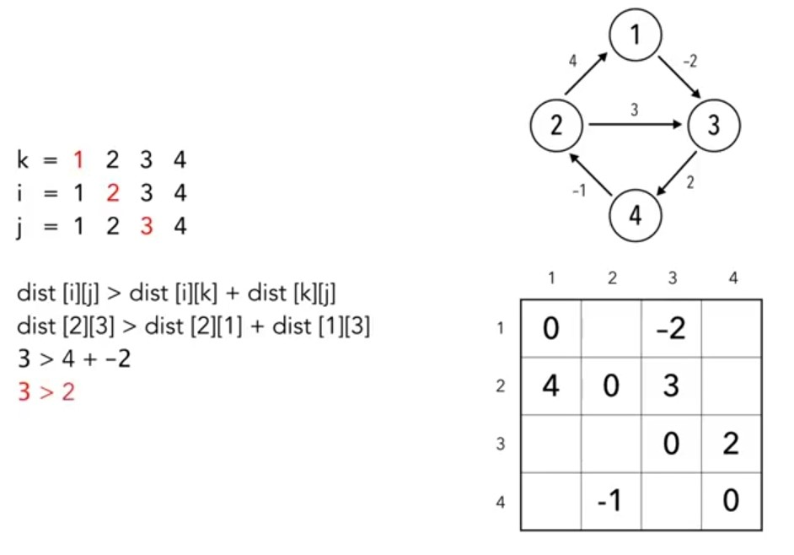
ALL PAIR SHORTEST PATH Example Problem
When condition becomes true we would overwrite the position in matrix.

Slide 14
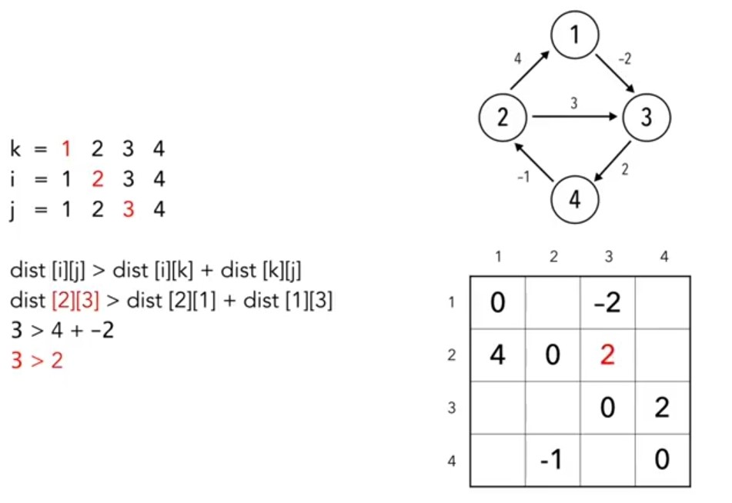
ALL PAIR SHORTEST PATH Example Problem

Slide 15
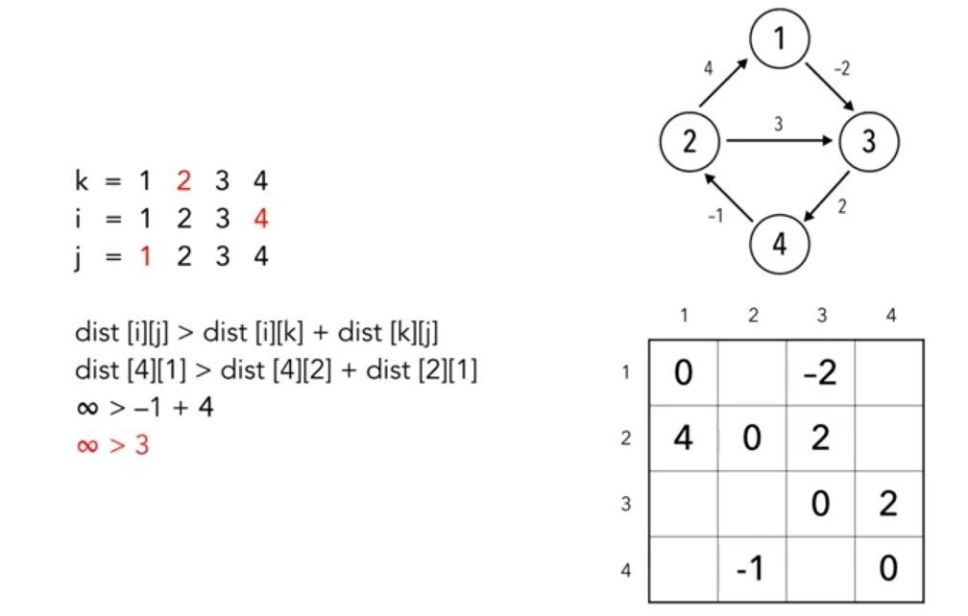
ALL PAIR SHORTEST PATH Example Problem
When condition becomes true we would overwrite the position in matrix.

Slide 16
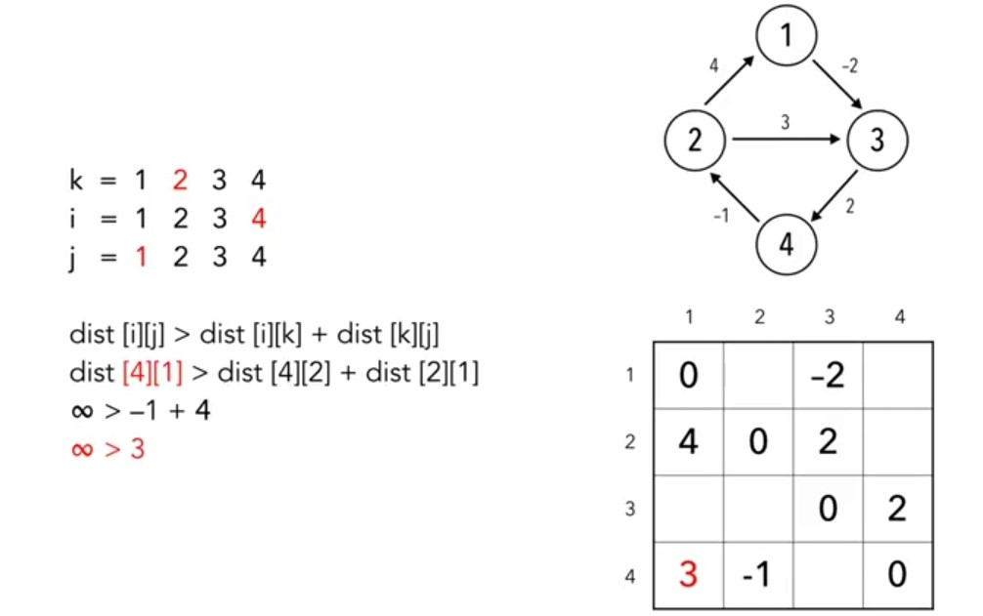
ALL PAIR SHORTEST PATH Example Problem

Slide 17
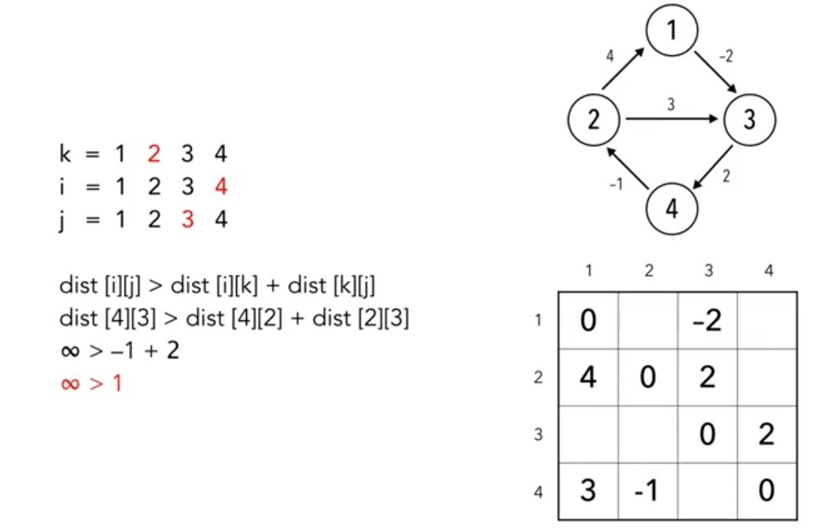
ALL PAIR SHORTEST PATH Example Problem
When condition becomes true we would overwrite the position in matrix

Slide 18
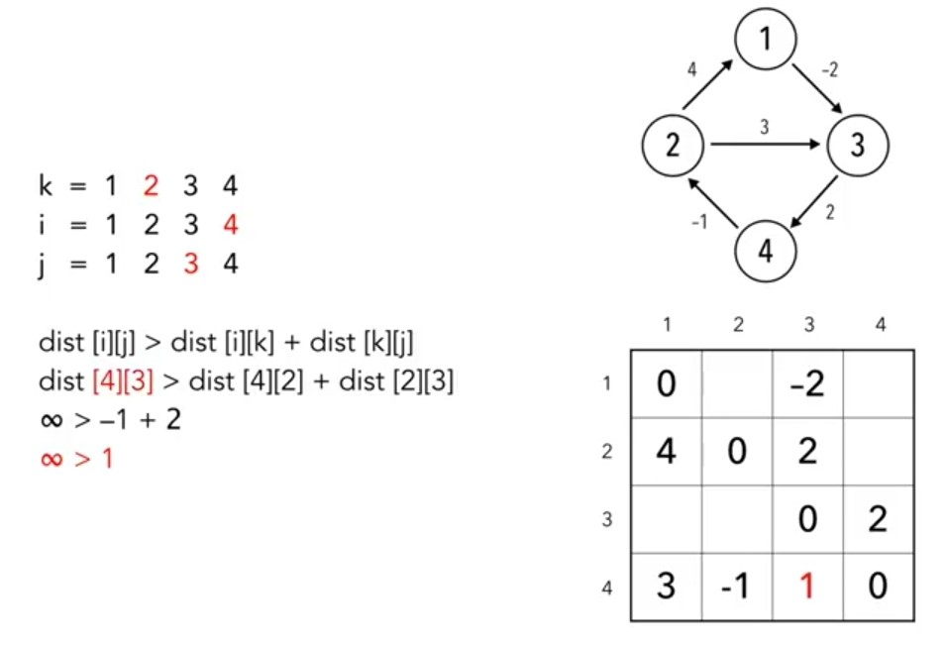
ALL PAIR SHORTEST PATH Example Problem

Slide 19
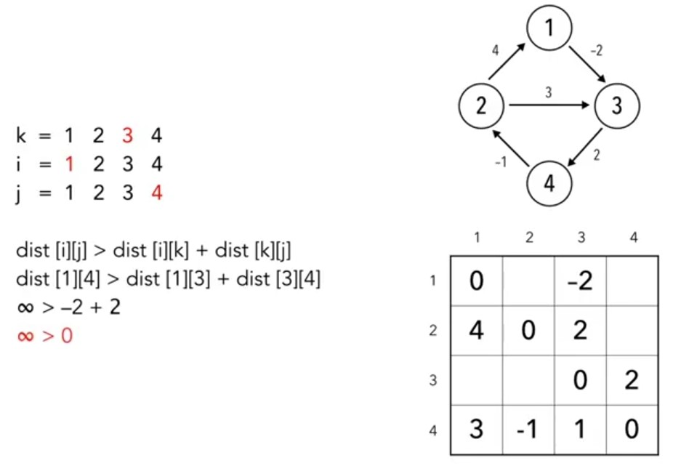
ALL PAIR SHORTEST PATH Example Problem
When condition becomes true we would overwrite the position in matrix

Slide 20
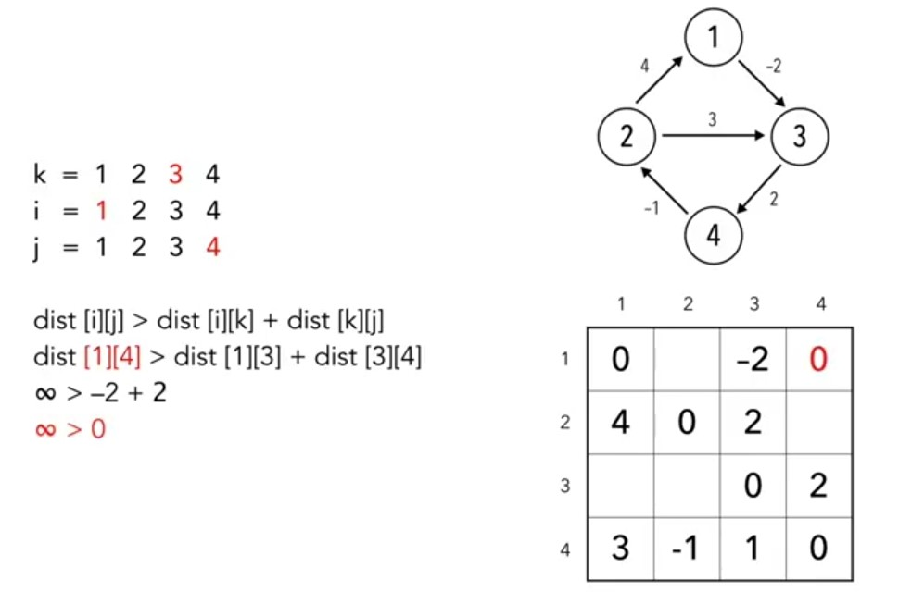
ALL PAIR SHORTEST PATH Example Problem
When condition becomes true we would overwrite the position in matrix

Slide 21
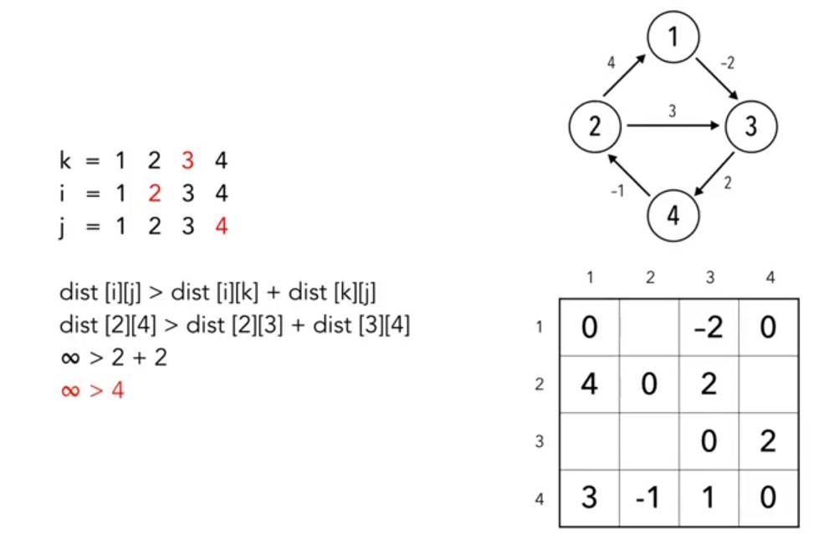
ALL PAIR SHORTEST PATH Example Problem

Slide 22
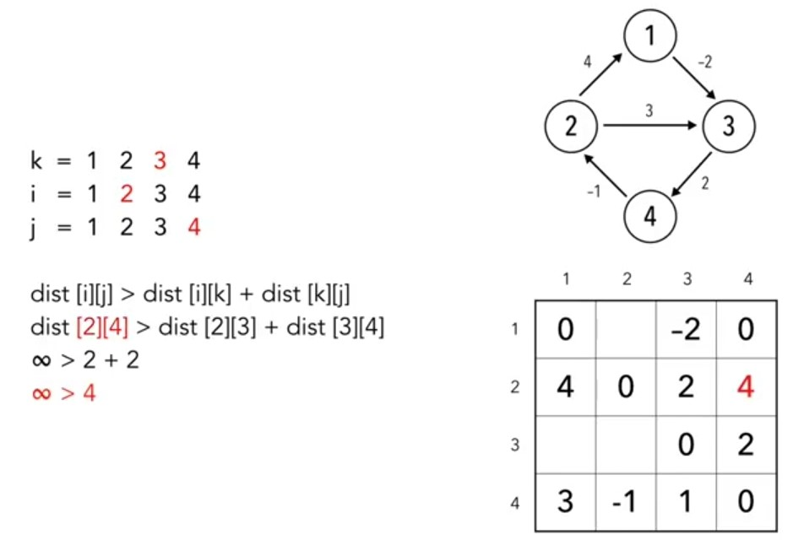
ALL PAIR SHORTEST PATH Example Problem
When condition becomes true we would overwrite the position in matrix

Slide 23
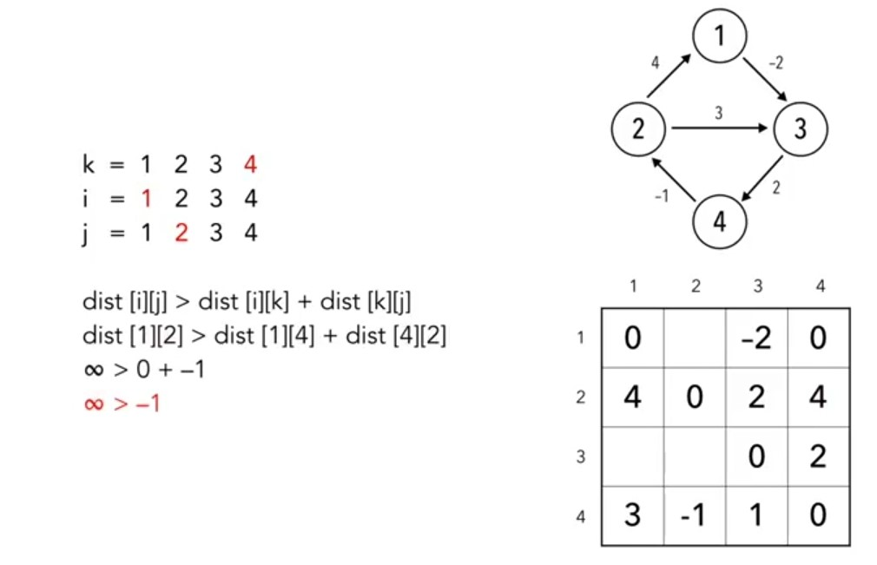
ALL PAIR SHORTEST PATH Example Problem

Slide 24
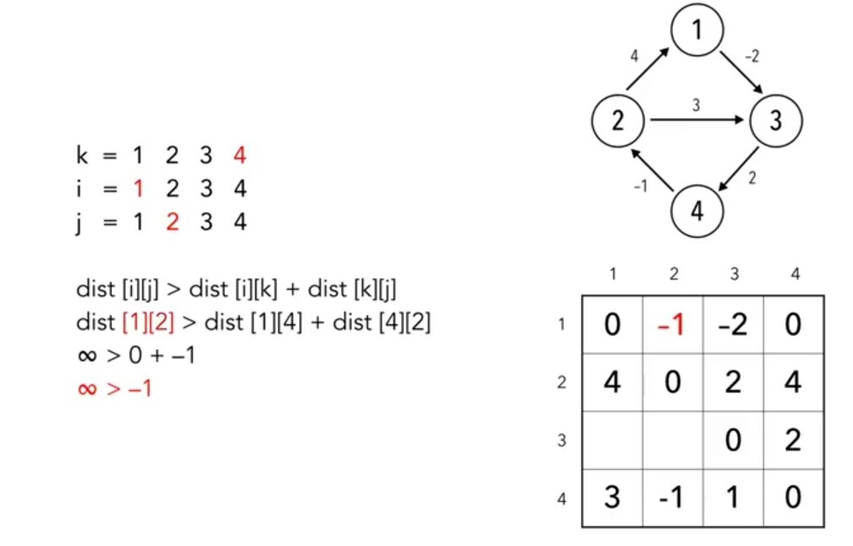
ALL PAIR SHORTEST PATH Example Problem
When condition becomes true we would overwrite the position in matrix

Slide 25
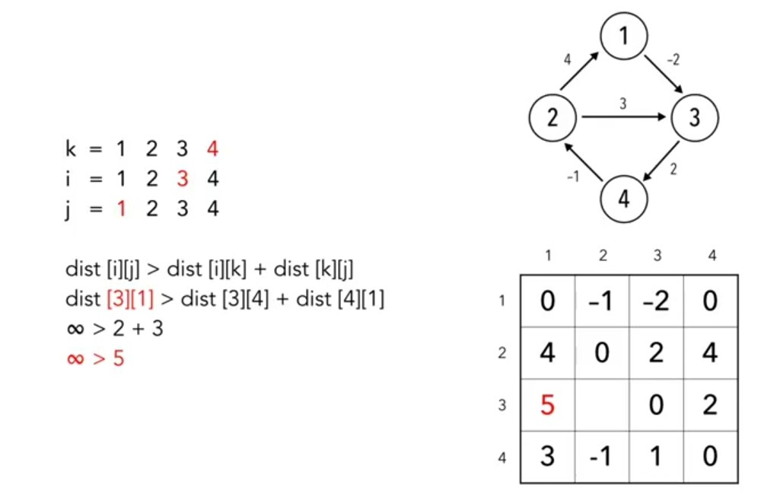
ALL PAIR SHORTEST PATH Example Problem

Slide 26
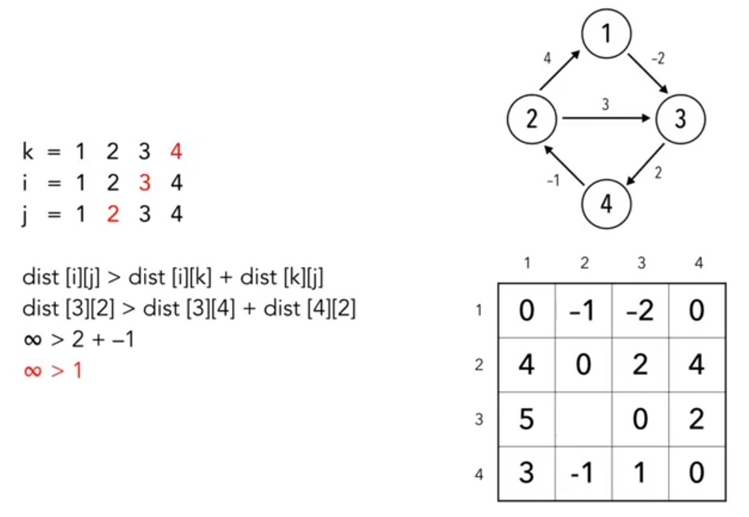
ALL PAIR SHORTEST PATH Example Problem
When condition becomes true we would overwrite the position in matrix

Slide 27
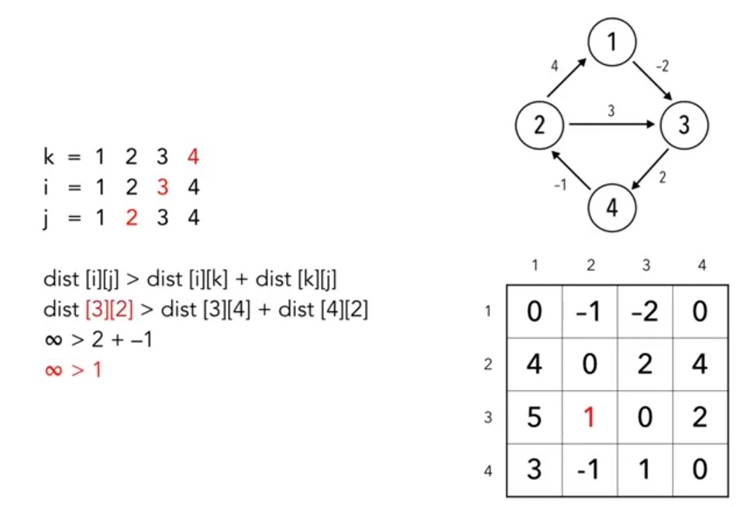
ALL PAIR SHORTEST PATH Example Problem

Slide 28
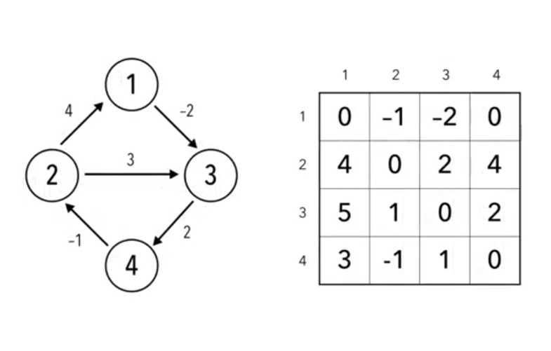
ALL PAIR SHORTEST PATH Example Problem
Final Resultant Matrix

Slide 29
ALL PAIR SHORTEST PATH
Time Complexity for this algorithm
O(|V|³)
where V is the number of vertices in graph.

